Slide 1
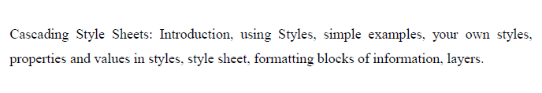
UNIT-II SYLLABUS

Slide 2
INTRODUCTION
CSS stands for Cascading Style Sheets.
CSS describes how HTML elements are to be displayed on screen, paper, or in other media.
CSS saves a lot of work. It can control the layout of multiple web pages all at once.
CSS is used to define styles for your web pages, including the design, layout and variations in display for different devices and screen sizes.

Slide 3
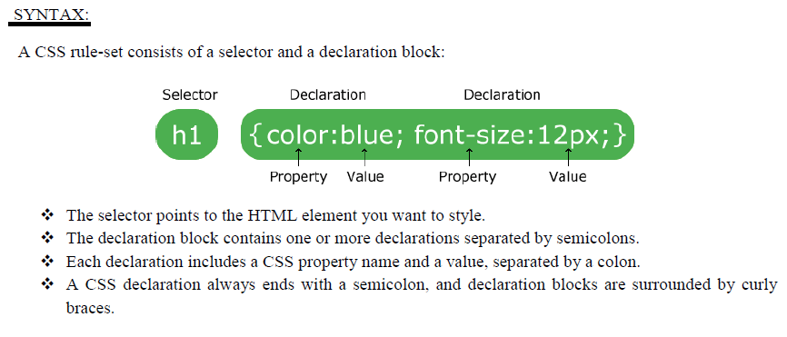

Slide 4
Example:
<html>
<head>
<title> Demo on CSS </title>
<style> p { color: red; text-align: center;font-size:20; } </style>
</head>
<body>
<p>Hello World!</p>
<p>Aditya Degree Colleges: Andhra Pradesh </p>
</body>
</html>

Slide 5
TYPES OF CSS :
There are three different types of CSS:
1. Inline CSS.
2. Internal / Embedded CSS.
3. External CSS.

Slide 6
Inline CSS:-
Inline CSS contains the CSS property in the body section attached with element is known as inline CSS. This kind of style is specified within an HTML tag using the style attribute.
It is used for a limited section.
Whenever our requirements are very small we can use inline CSS.
It will affect only single element.
It must be specified on every HTML tag.
It is not the best practice for a good programmer and the code will be quite large and very complex.

Slide 7
Example:
<html>
<head>
<title> Demo on Inline CSS </title>
</head>
<body>
<p style = "color:#009900; font-size:50px;
font-style:italic; text-align:center;">
Aditya Degree Colleges
</p>
<p style = "color:blue; font-size:100px;
font-style:bold; text-align:left;">
Andhra Pradesh
</p>
</body>
</html>

Slide 8
Internal or Embedded CSS: -
This can be used when a single HTML document must be styled uniquely. The CSS rule set should be within the HTML file in the head section i.e the CSS is embedded within the HTML file.
In internal CSS the style of CSS is specified in the <head> section.
it affects all the elements in the body section.

Slide 9
Example 1:
<html>
<head>
<title> Demo on CSS </title>
<style>
body {background-color: powderblue;}
h1{color: blue;}
p{color: red;}
</style>
</head>
<body>
<h1>This is a heading</h1>
<p>This is a paragraph.</p>
</body>
</html>

Slide 10
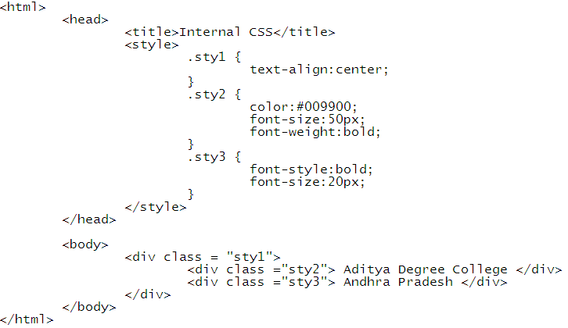
Example 2:

Slide 11
External CSS
External CSS contains separate CSS file which contains only style property with the help of tag attributes (For example class, id, heading, … etc).
CSS property written in a separate file with .css extension and should be linked to the HTML document using link tag. This means that for each element, style can be set only once and that will be applied across web pages.
There is no need to rewrite the CSS style again and again in a complete body of HTML that inherits the property of the CSS file.

Slide 12
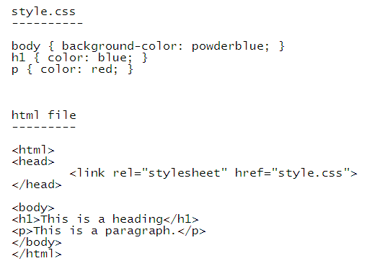
Example :

Slide 13
here
link tag is used to link the external style sheet with the html webpage.
The rel attribute defines the relationship between a linked resource and the current document.
href attribute is used to specify the location of the external style sheet file.

